Slide 1
Sensory Physiology

Slide 2
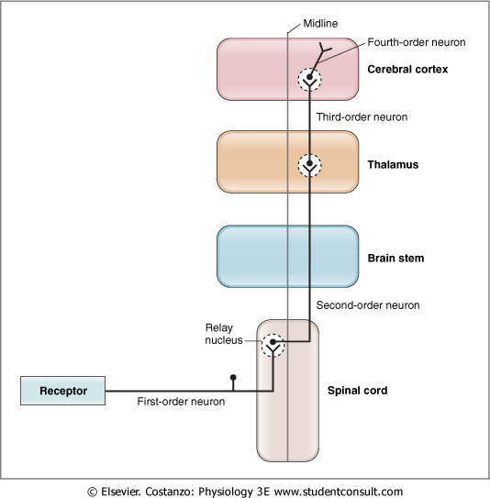
Sensory systems receive information from the environment via specialized receptors in the periphery and transmit this information through a series of neurons and synaptic relays to the CNS.

Slide 3
Sensory receptors
Activated by stimuli in the environment.
The nature of the receptors varies from one sensory modality to the next.
In the visual, taste, and auditory systems, the receptors are specialized epithelial cells.
In the somatosensory and olfactory systems, the receptors are first-order, or primary afferent, neurons.
sensory transduction - basic function of the receptors convert a stimulus (e.g., sound waves, electromagnetic waves, or pressure) into electrochemical energy. .
sensory transduction mediated through opening or closing specific ion channels.
receptor potential - changes in membrane potential (depolarization or hyperpolarization) sensory receptors as a result, the opening or closing of ion channels.

Slide 4
First-order sensory afferent neurons.
The primary sensory afferent neuron; in some cases (somatosensory, olfaction), it also is the receptor cell.
When the sensory receptor is a specialized epithelial cell, it synapses on a first-order neuron.
When the receptor is also the primary afferent neuron, there is no need for this synapse.
The primary afferent neuron has its cell body in a dorsal root or spinal cord ganglion.

Slide 5
Second-order sensory afferent neurons.
First-order neurons synapse on second-order neurons in relay nuclei, which are located in the spinal cord or in the brain stem.
Axons of the second-order neurons leave the relay nucleus and ascend to the next relay, located in the thalamus, where they synapse on third-order neurons.
En route to the thalamus, the axons of these second-order neurons cross at the midline.
The decussation, or crossing, may occur in the spinal cord or in the brain stem.

Slide 6
Third-order sensory afferent neurons.
Third-order neurons typically reside in relay nuclei in the thalamus.
Many second-order neurons synapse on a single third-order neuron.
The relay nuclei process the information they receive via local interneurons, which may be excitatory or inhibitory.

Slide 7
Fourth-order sensory afferent neurons.
Fourth-order neurons reside in the appropriate sensory area of the cerebral cortex. For example, in the auditory pathway, fourth-order neurons are found in the primary auditory cortex; in the visual pathway, they reside in the primary visual cortex; and so forth.
As noted, there are secondary and tertiary areas as well as association areas in the cortex, all of which integrate complex sensory information.

Slide 8
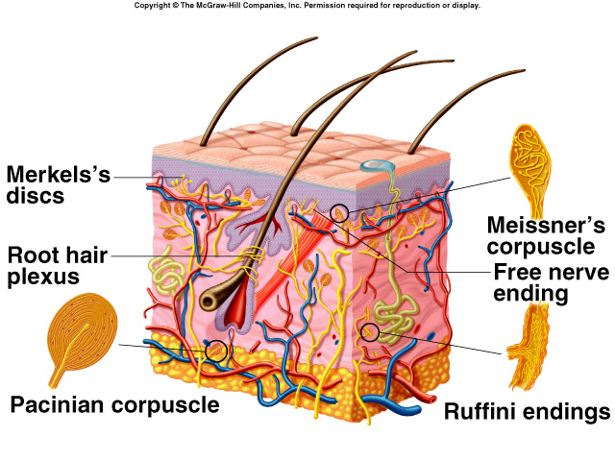
Structural Categories of Sensory Receptors
Dendritic endings of sensory neurons:
Free:
Pain, temperature.
Encapsulated:
Pressure.
Touch.
Rods and cones:
Sight.
Modified epithelial cells:
Taste.

Slide 9
Functional Categories of Sensory Receptors
Grouped according to type of stimulus energy they transduce.
Chemoreceptors:
Chemical stimuli in environment or blood (pH, C0₂).
Photoreceptors:
Rods and cones.
Thermoreceptors:
Temperature.
Mechanoreceptors:
Touch and pressure.
Nociceptors:
Pain.
Proprioceptors:
Body position.

Slide 10
Categorized according to type of sensory information delivered to brain:
General senses—Temperature, pain, touch, pressure, vibration, and proprioception. Receptors throughout the body
Special senses—Smell, taste, vision, balance, and hearing. Receptors located in sense organs (e.g., ear, eye).

Slide 11
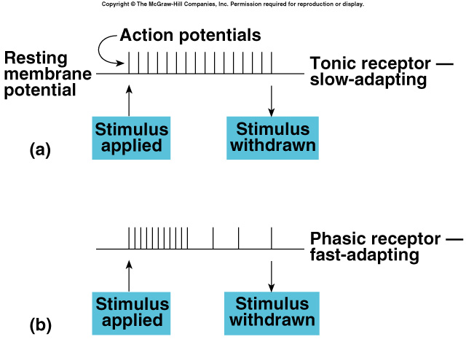
Sensory Adaptation
Tonic receptors:
Produce constant rate of firing as long as stimulus is applied.
Pain.
Phasic receptors:
Burst of activity but quickly reduce firing rate (adapt) if stimulus maintained.
Sensory adaptation:
Cease to pay attention to constant stimuli.

Slide 12
Law of Specific Nerve Energies
Sensation characteristic of each sensory neuron is that produced by its normal or adequate stimulus.
Adequate stimulus:
Requires least amount of energy to activate a receptor.
Regardless of how a sensory neuron is stimulated, only one sensory modality will be perceived.
Allows brain to perceive the stimulus accurately under normal conditions.

Slide 13
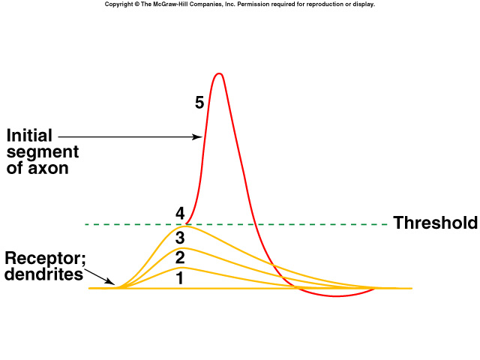
Generator Potentials
In response to stimulus, sensory nerve endings produce a local graded change in membrane potential.
Potential changes are called receptor or generator potential.
Analogous to EPSPs.
Receptor potential does not cause the action potential of.
Phasic response:
Generator potential increases with increased stimulus, then as stimulus continues, generator potential size diminishes.
Tonic response:
Generator potential proportional to intensity of stimulus.

Slide 14
Vision
Eyes transduce energy in the electromagnetic spectrum into APs.
Only wavelengths of 400 – 700 nm constitute visible light.
Neurons in the retina contribute fibers that are gathered together at the optic disc, where they exit as the optic nerve.

Slide 15
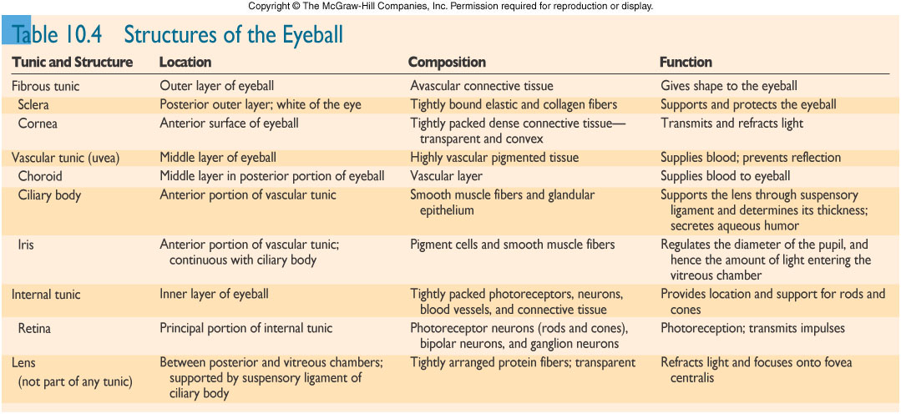

Slide 16
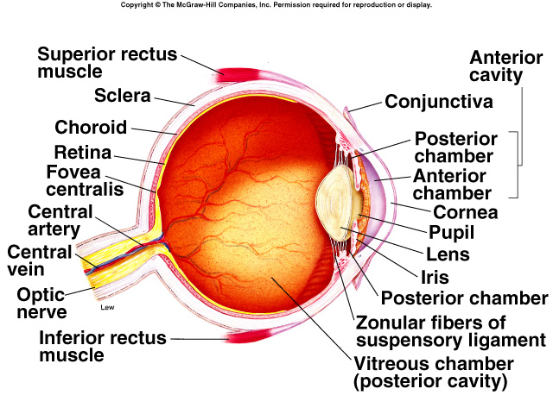
Refraction
Light that passes from a medium of one density into a medium of another density (bends).
Refractive index (degree of refraction) depends upon:
Comparative density of the 2 media.
Refractive index of air = 1.00.
Refractive index of cornea = 1.38.
Curvature of interface between the 2 media.
Image is inverted on retina.

Slide 17
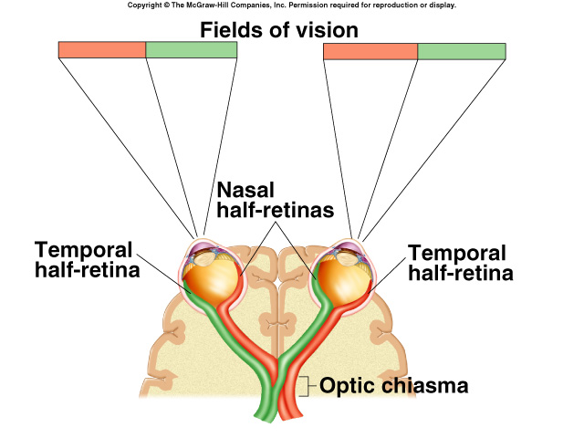
Visual Field
Image projected onto retina is reversed in each eye.
Cornea and lens focus the right part of the visual field on left half of retina.
Left half of visual field focus on right half of each retina.

Slide 18
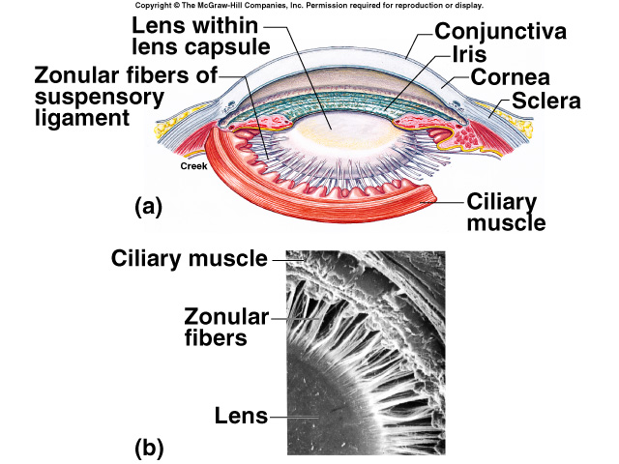
Accommodation
Ability of the eyes to keep the image focused on the retina as the distance between the eyes and object varies.

Slide 19
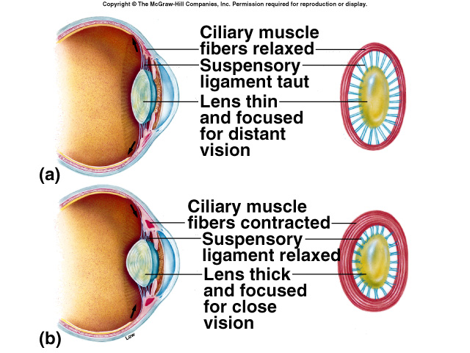
Changes in the Lens Shape
Ciliary muscle can vary its aperture.
Distance > 20 feet:
Relaxation places tension on the suspensory ligament.
Pulls lens taut.
Lens is least convex.
Distance decreases:
Ciliary muscles contract.
Reducing tension on suspensory ligament.
Lens becomes more rounded and more convex.

Slide 20
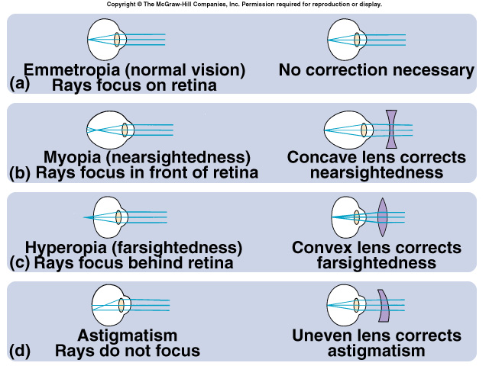
Visual Acuity
Sharpness of vision.
Depends upon resolving power:
Ability of the visual system to resolve 2 closely spaced dots.
Myopia (nearsightedness):
Image brought to focus in front of retina.
Hyperopia (farsightedness):
Image brought to focus behind the retina.
Astigmatism:
Asymmetry of the cornea and/or lens.
Images of lines of circle appear blurred.

Slide 21
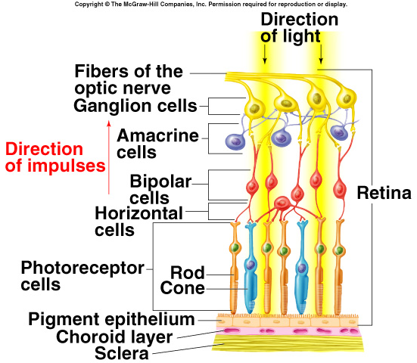
Retina
Consists of single-cell-thick pigmented epithelium, layers of other neurons, and photoreceptor neurons (rods and cones).
Neural layers are forward extension of the brain.
Neural layers face outward, toward the incoming light.
Light must pass through several neural layers before striking the rods and cones.

Slide 22
Retina (continued)
Rods and cones synapse with other neurons.
Each rod and cone consists of inner and outer segments.
Outer segment contains hundreds of flattened discs with photopigment molecules.
New discs are added and retinal pigment epithelium removes old tip regions.
Outer layers of neurons that contribute axons to optic nerve called ganglion cells.
Neurons receive synaptic input from bipolar cells, which receive input from rods and cones.
Horizontal cells synapse with photoreceptors and bipolar cells.
Amacrine cells synapse with several ganglion cells.
APs conducted outward in the retina.

Slide 23
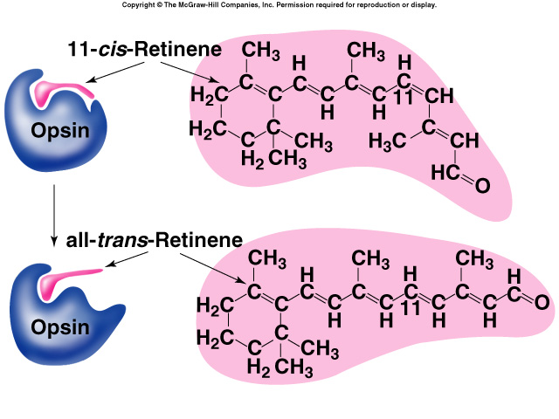
Effect of Light on Rods
Rods and cones are activated when light produces chemical change in rhodopsin.
Bleaching reaction:
Rhodopsin dissociates into retinene (rentinaldehyde) and opsin.
11-cis retinene dissociates from opsin when converted to all-trans form.
Initiates changes in ionic permeability to produce APs in ganglionic cells.

Slide 24
Dark Adaptation
Gradual increase in photoreceptor sensitivity when entering a dark room.
Maximal sensitivity reached in 20 min.
Increased amounts of visual pigments produced in the dark.
Increased pigment in cones produces slight dark adaptation in 1st 5 min.
Increased rhodopsin in rods produces greater increase in sensitivity.
100,00-fold increase in light sensitivity in rods.

Slide 25
Electrical Activity of Retinal Cells
Ganglion cells and amacrine cells are only neurons that produce APs.
Rods and cones; bipolar cells, horizontal cells produce EPSPs and IPSPs.
In dark, photoreceptors release inhibitory NT that hyperpolarizes bipolar neurons.
Light inhibits photoreceptors from releasing inhibitory NT.
Stimulates bipolar cells through ganglion cells to transmit APs.
Dark current:
Rods and cones contain many Na⁺ channels that are open in the dark.
Causes slight membrane depolarization in dark.

Slide 26
Electrical Activity of Retinal Cells (continued)
Na⁺ channels rapidly close in response to light.
cGMP required to keep the Na⁺ channels open.
Opsin dissociation causes the alpha subunits of G-proteins to dissociate.
G-protein subunits bind to and activate phosphodiesterase, converting cGMP to GMP.
Na⁺ channels close when cGMP converted to GMP.
Absorption of single photon of light can block Na⁺ entry:
Hyperpolarizes and release less inhibiting NT.
Light can be perceived.

Slide 27
Cones and Color Vision
Cones less sensitive than rods to light.
Cones provide color vision and greater visual acuity.
High light intensity bleaches out the rods, and color vision with high acuity is provided by cones.
Trichromatic theory of color vision:
3 types of cones:
Blue, green, and red.
According to the region of visual spectrum absorbed.

Slide 28
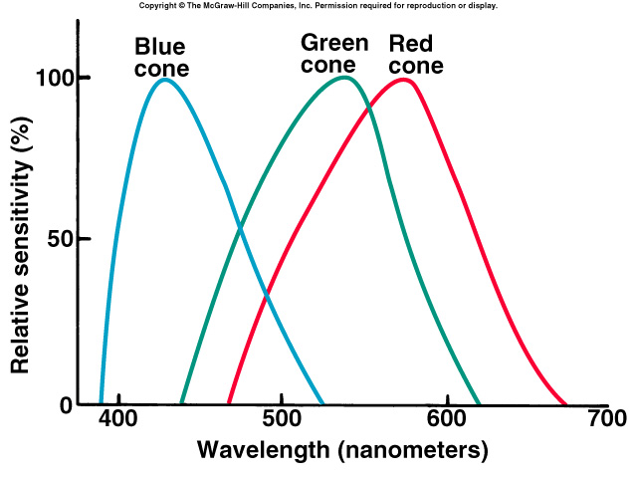
Cones and Color Vision (continued)
Each type of cone contains retinene associated with photopsins.
Photopsin protein is unique for each of the 3 cone pigment.
Each cone absorbs different wavelengths of light.

Slide 29
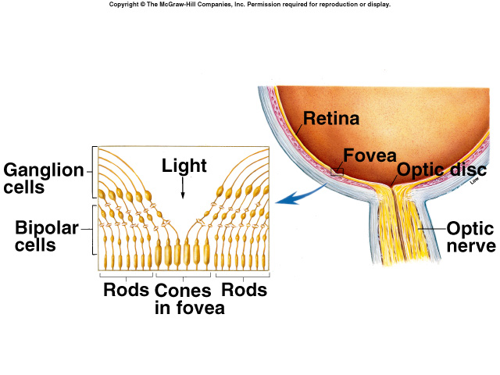
Visual Acuity and Sensitivity
Each eye oriented so that image falls within fovea centralis.
Fovea only contain cones.
Degree of convergence of cones is 1:1.
Peripheral regions contain both rods and cones.
Degree of convergence of rods is much lower.
Visual acuity greatest and sensitivity lowest when light falls on fovea.

Slide 30
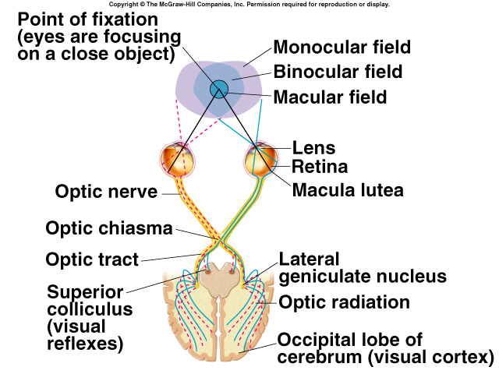
Neural Pathways from Retina
Right half of visual field projects to left half of retina of both eyes.
Left half of visual field projects to right half of retina of both eyes.
Left lateral geniculate body receives input from both eyes from the right half of the visual field.
Right lateral geniculate body receives input from both eyes from left half of visual field.

Slide 31
Eye Movements
Superior colliculus coordinate:
Smooth pursuit movements:
Track moving objects.
Keep image focused on the fovea.
Saccadic eye movements:
Quick, jerky movements.
Occur when eyes appear still.
Move image to different photoreceptors.
Ability of the eyes to jump from word to word as you read a line.
Pupillary reflex:
Shining a light into one eye, causing both pupils to constrict.
Activation of parasympathetic neurons.

Slide 32
Neural Processing of Visual Information
Receptive field:
Part of visual field that affects activity of particular ganglion cell.
On-center fields:
Responses produced by light in the center of visual fields.
Off-center fields:
Responses inhibited by light in the center, and stimulated by light in the surround.

Slide 33
Ears and Hearing
Sound waves travel in all directions from their source.
Waves are characterized by frequency and intensity.
Frequency:
Measured in hertz (cycles per second).
Pitch is directly related to frequency.
Greater the frequency the higher the pitch.
Intensity (loudness):
Directly related to amplitude of sound waves.
Measured in decibels.

Slide 34
Outer Ear
Sound waves are funneled by the pinna (auricle) into the external auditory meatus.
External auditory meatus channels sound waves to the tympanic membrane.
Increases sound wave intensity.

Slide 35
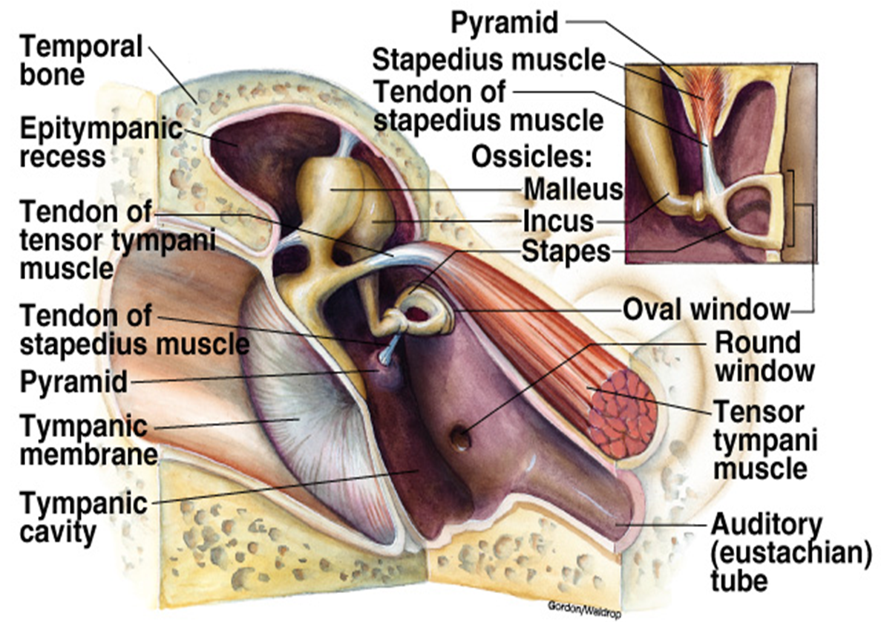
Middle Ear
Cavity between tympanic membrane and cochlea.
Malleus:
Attached to tympanic membrane.
Vibrations of membrane are transmitted to the malleus and incus to stapes.
Stapes:
Attached to oval window.
Vibrates in response to vibrations in tympanic membrane.
Vibrations transferred through 3 bones:
Provides protection and prevents nerve damage.
Stapedius muscle contracts and dampens vibrations.

Slide 36
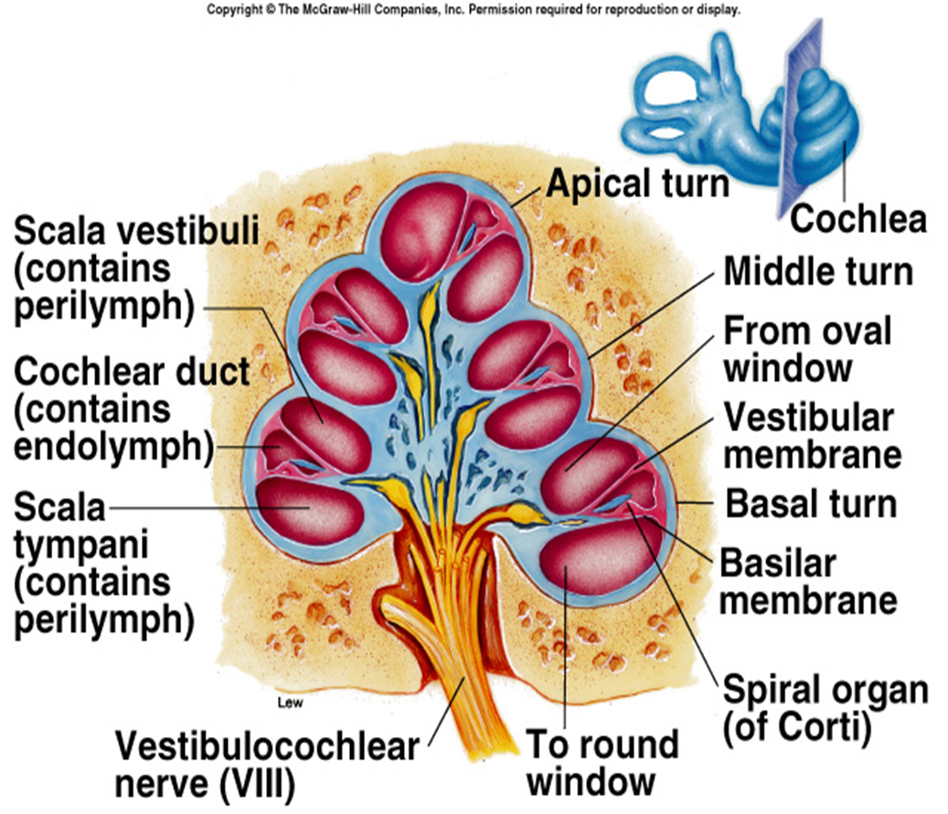
Cochlea
Vibrations by stapes and oval window produces pressure waves that displace perilymph fluid within scala vestibuli.
Vibrations pass to the scala tympani.
Movements of perilymph travel to the base of cochlea where they displace the round window.
As sound frequency increases, pressure waves of the perilymph are transmitted through the vestibular membrane to the basilar membrane.

Slide 37
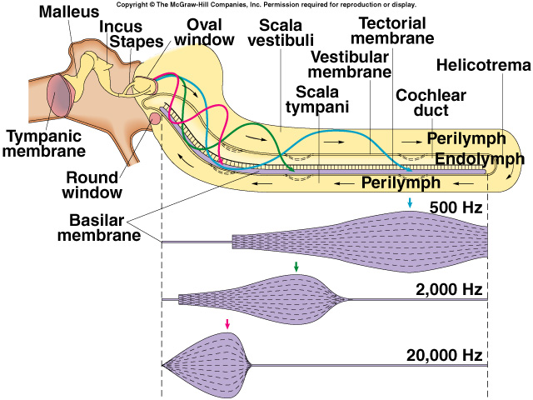
Effects of Different Frequencies
Displacement of basilar membrane is central to pitch discrimination.
Waves in basilar membrane reach a peak at different regions depending upon pitch of sound.
Sounds of higher frequency cause maximum vibrations of basilar membrane.

Slide 38
Spiral Organ (Organ of Corti)
Sensory hair cells (stereocilia) located on the basilar membrane.
Arranged to form 1 row of inner cells.
Extends the length of basilar membrane.
Multiple rows of outer stereocilia are embedded in tectorial membrane.
When the cochlear duct is displaced, a shearing force is created between basilar membrane and tectorial membrane, moving and bending the stereocilia.

Slide 39
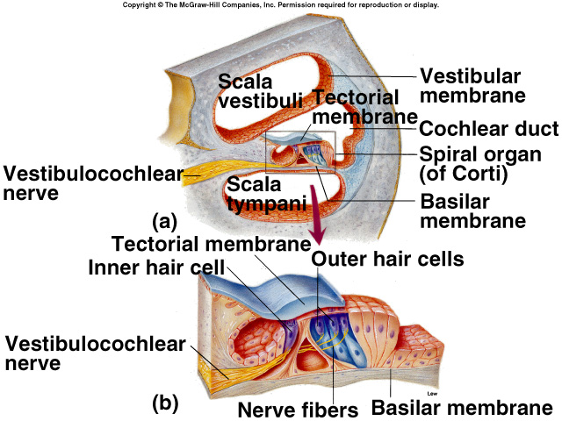
Organ of Corti (continued)
Ion channels open, depolarizing the hair cells, releasing glutamate that stimulates a sensory neuron.
Greater displacement of basilar membrane, bending of stereocilia; the greater the amount of NT released.
Increases frequency of APs produced.

Slide 40
Neural Pathway for Hearing
Sensory neurons in cranial nerve VIII synapse with neurons in medulla.
These neurons project to inferior colliculus of midbrain.
Neurons in this area project to thalamus.
Thalamus sends axons to auditory cortex.
Neurons in different regions of basilar membrane stimulate neurons in the corresponding areas of the auditory cortex.
Each area of cortex represents a different part of the basilar membrane and a different pitch.

Slide 41
Hearing Impairments
Conduction deafness:
Transmission of sound waves through middle ear to oval window impaired.
Impairs all sound frequencies.
Hearing aids.
Sensorineural (perception) deafness:
Transmission of nerve impulses is impaired.
Impairs ability to hear some pitches more than others.
Cochlear implants.

Slide 42
Cutaneous Sensations
Mediated by dendritic nerve endings of different sensory neurons.
Free nerve endings:
Temperature: heat and cold.
Receptors for cold located in upper region of dermis.
Receptors for warm located deeper in dermis.
More receptors respond to cold than warm.
Hot temperature produces sensation of pain through a capsaicin receptor.
Ion channels for Ca²⁺ and Na⁺ to diffuse into the neuron.

Slide 43
Cutaneous Sensations (continued)
Nociceptors (pain):
Use substance P or glutamate as NT.
Ca²⁺ and Na⁺ enter through channel, depolarizing the cell.
Encapsulated nerve endings:
Touch and pressure.
Receptors adapt quickly.
Ruffini endings and Merkel’s discs:
Sensation of touch.
Slow adapting.

Slide 44
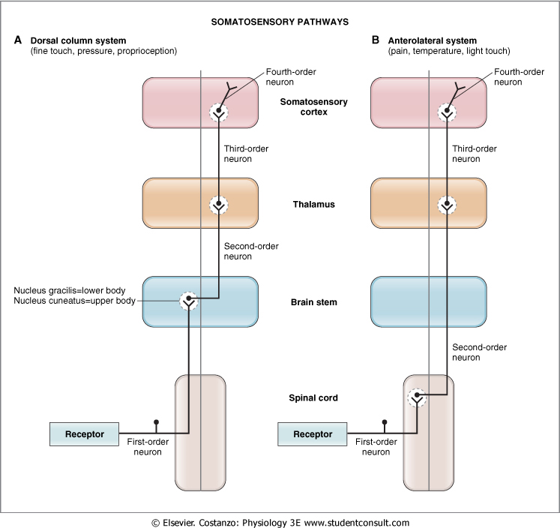
Neural Pathways for Somatesthetic Sensations
Sensory information from proprioceptors and cutaneous receptors are carried by large, myelinated nerve fibers.
Synapse in medulla.
2nd order neuron ascends medial lemniscus to thalamus.
Synapses with 3rd order neurons, which project to sensory cortex.
Lateral spinothalamic tract:
Heat, cold, and pain.
Anterior spinothalamic tract:
Touch and pressure.

Slide 45
Receptive Fields
Area of skin whose stimulation results in changes in the firing rate of the neuron.
Area of each receptor field varies inversely with the density of receptors in the region.
Back and legs have few sensory endings.
Receptive field is large.
Fingertips have large # of cutaneous receptors.
Receptive field is small.

Slide 46
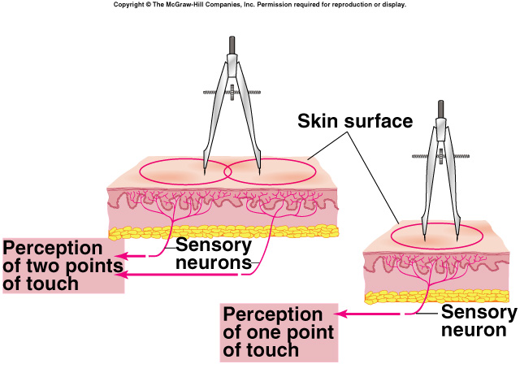
Two-Point Touch Threshold
Minimum distance at which 2 points of touch can be perceived as separate.
Measures of distance between receptive fields.
Indication of tactile acuity.
If distance between 2 points is less than minimum distance, only 1 point will be felt.

Slide 47
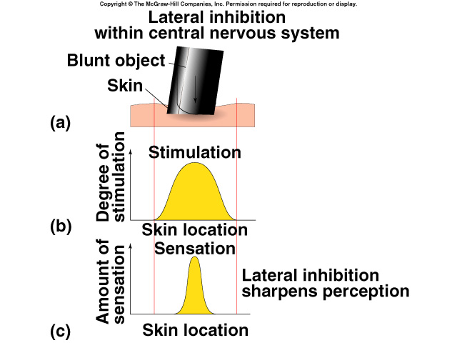
Lateral Inhibition
Sharpening of sensation.
When a blunt object touches the skin, sensory neurons in the center areas are stimulated more than neighboring fields.
Stimulation will gradually diminish from the point of greatest contact, without a clear, sharp boundary.
Will be perceived as a single touch with well defined borders.
Occurs within CNS.

Slide 48
Interoceptive analyzer
Its receptors termed interoreceptors, are scattered in all organs of vegetative life (viscera, vessels, smooth muscles).
four types of interoception –
mechanoreceptors,
chemoreceptors,
thermoreceptors and
osmoreceptor.
Doesn’t possess a compact conducting pathway. The conductor – is formed of afferent fibres of vegetative nervous system, running in the cranial nerves, and carrying impulses from organs.
At the level of pathways spinal cord and brain revealed no clear neurophysiological differences between the fibers of the somatic and visceral sensitivity.
Finally, the cells of the 3rd link are located in thalamus.
In normal physiological conditions interoceptive signals do not reach the level of consciousness. Intense visceral afferentation able to reach the level of consciousness.

Slide 49
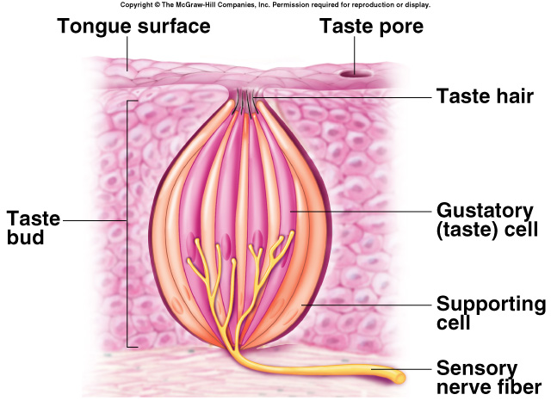
Taste
Gustation:
Sensation of taste.
Epithelial cell receptors clustered in barrel-shaped taste buds.
Each taste bud consists of 50-100 specialized epithelial cells.
Taste cells are not neurons, but depolarize upon stimulation and if reach threshold, release NT that stimulate sensory neurons.

Slide 50
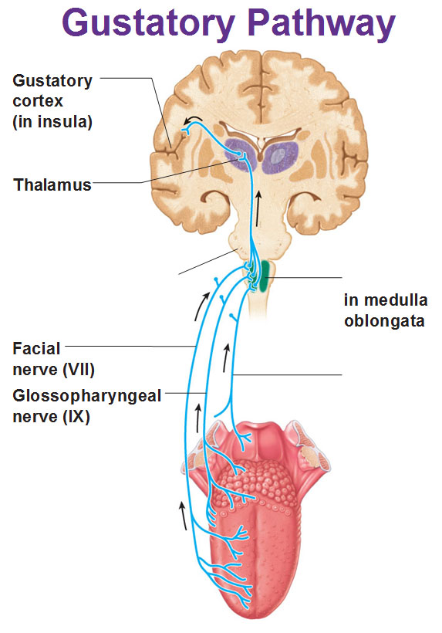
Taste (continued)
Each taste bud contains taste cells responsive to each of the different taste categories.
A given sensory neuron may be stimulated by more than 1 taste cell in # of different taste buds.
One sensory fiber may not transmit information specific for only 1 category of taste.
Brain interprets the pattern of stimulation with the sense of smell; so that we perceive the complex tastes.

Slide 51
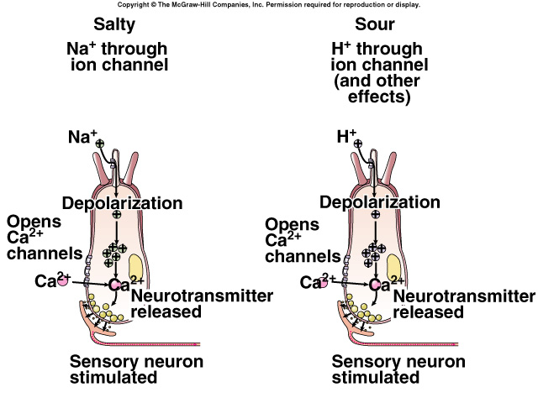
Taste Receptor Distribution
Salty:
Na⁺ passes through channels, activates specific receptor cells, depolarizing the cells, and releasing NT.
Anions associated with Na⁺ modify perceived saltiness.
Sour:
Presence of H⁺ passes through the channel.

Slide 52
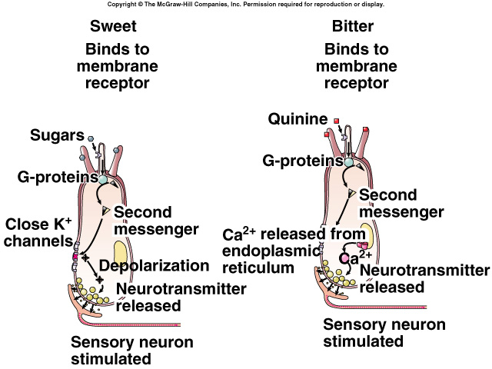
Taste Receptor Distribution (continued)
Sweet and bitter:
Mediated by receptors coupled to G-protein (gustducin).

Slide 53
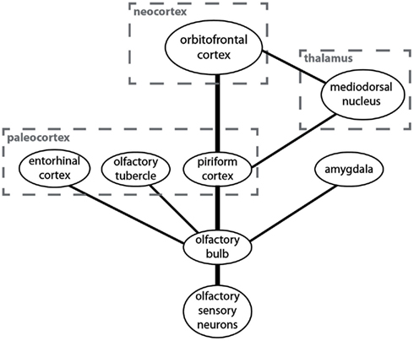
Smell (olfaction)
Olfactory apparatus consists of receptor cells, supporting cells and basal (stem) cells.
Basal cells generate new receptor cells every 1-2 months.
Supporting cells contain enzymes that oxidize hydrophobic volatile odorants.
Bipolar sensory neurons located within olfactory epithelium are pseudostratified.
Axon projects directly up into olfactory bulb of cerebrum.
Olfactory bulb projects to olfactory cortex, hippocampus, and amygdaloid nuclei.
Synapses with 2nd order neuron.
Dendrite projects into nasal cavity where it terminates in cilia.
Neuronal glomerulus receives input from 1 type of olfactory receptor.

Slide 54
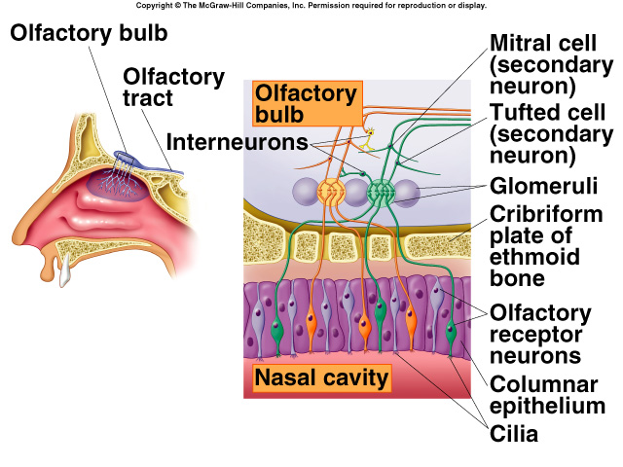
Smell (continued)
Odorant molecules bind to receptors and act through G-proteins to increase cAMP.
Open membrane channels, and cause generator potential; which stimulate the production of APs.
Up to 50 G-proteins may be associated with a single receptor protein.
Dissociation of these G-proteins releases may G- subunits.
Amplify response.

Slide 55
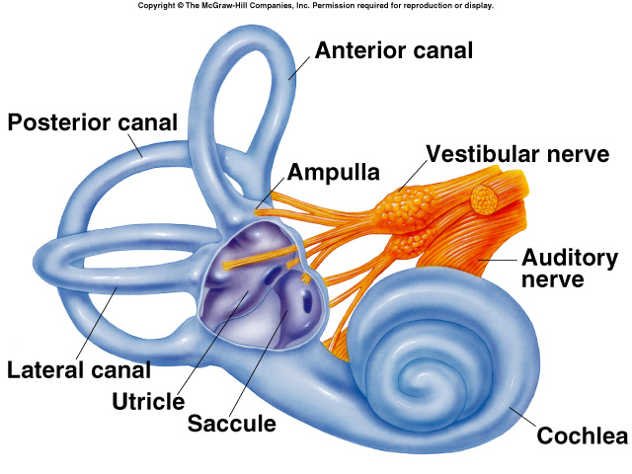
Vestibular Apparatus and Equilibrium
Sensory structures of the vestibular apparatus is located within the membranous labyrinth.
Filled with endolymph.
Equilibrium (orientation with respect to gravity) is due to vestibular apparatus.
Vestibular apparatus consists of 2 parts:
Otolith organs:
Utricle and saccule.
Semicircular canals.

Slide 56
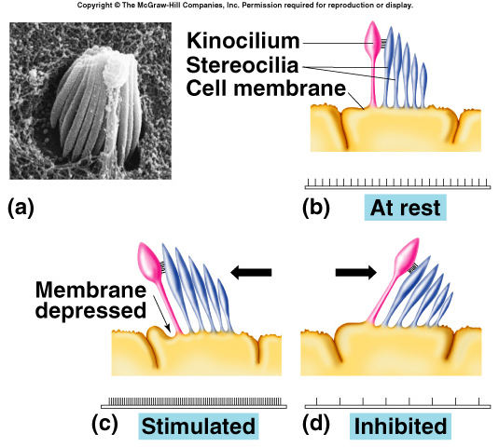
Sensory Hair Cells of the Vestibular Apparatus
Utricle and saccule:
Provide information about linear acceleration.
Hair cell receptors:
Stereocilia and kinocilium:
When stereocilia bend toward kinocilium; membrane depolarizes, and releases NT that stimulates dendrites of VIII.
When bend away from kinocilium, hyperpolarization occurs.
Frequency of APs carries information about movement.

Slide 57
Utricle and Saccule
Each have macula with hair cells.
Hair cells project into endolymph, where hair cells are embedded in a gelatinous otolithic membrane.
Otolithic membrane contains crystals of Ca²⁺ carbonate that resist change in movement.
Utricle:
More sensitive to horizontal acceleration.
During forward acceleration, otolithic membrane lags behind hair cells, so hairs pushed backward.
Saccule:
More sensitive to vertical acceleration.
Hairs pushed upward when person descends.

Slide 58
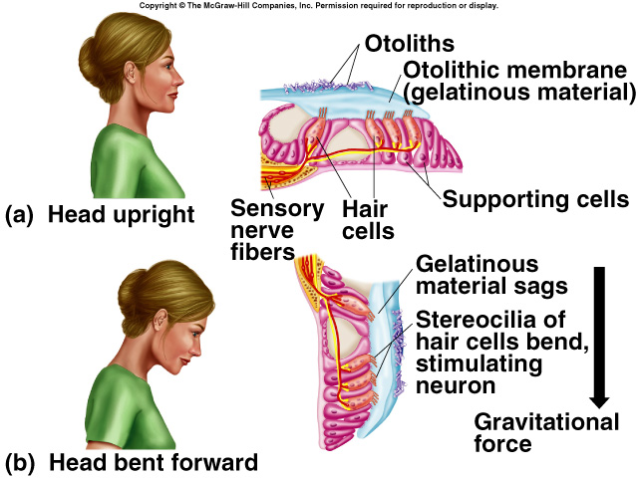
Utricle and Saccule (continued)

Slide 59
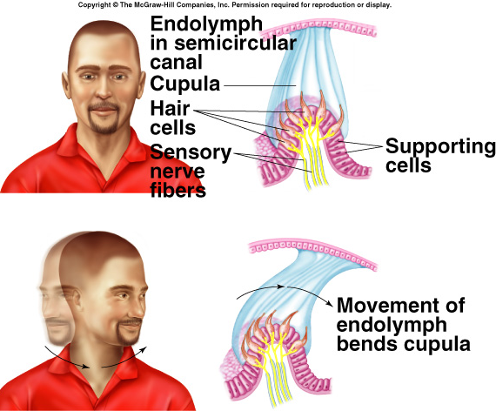
Semicircular Canals
Provide information about rotational acceleration.
Project in 3 different planes.
Each canal contains a semicircular duct.
At the base is the crista ampullaris, where sensory hair cells are located.
Hair cell processes are embedded in the cupula.
Endolymph provides inertia so that the sensory processes will bend in direction opposite to the angular acceleration.

Slide 60
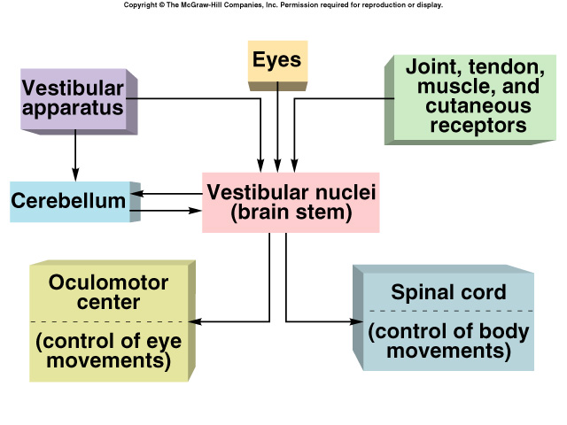
Neural Pathways
Stimulation of hair cells in vestibular apparatus activates sensory neurons of VIII.
Sensory fibers transmit impulses to cerebellum and vestibular nuclei of medulla.
Sends fibers to oculomotor center.
Neurons in oculomotor center control eye movements.
Neurons in spinal cord stimulate movements of head, neck, and limbs.

Slide 61
Nystagmus and Vertigo
Nystagmus:
Involuntary oscillations of the eyes, when spin is stopped. Eyes continue to move in direction opposite to spin, then jerk rapidly back to midline.
When person spins, the bending of cupula occurs in the opposite direction.
As the spin continues, the cupula straightens.
Endolymph and cupula are moving in the same direction and speed affects muscular control of eyes and body.
If movement suddenly stops, the inertia of endolymph causes it to continue moving in the direction of spin.
Vertigo:
Loss of equilibrium when spinning.
May be caused by anything that alters firing rate.
Pathologically, viral infections.

